Slide 1
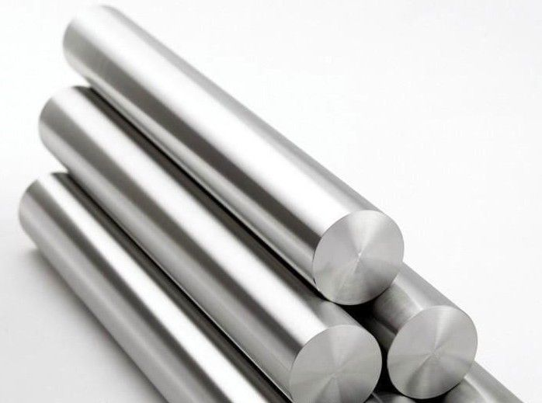


Hiho Group
Presentation

Slide 2
Contents
I. | Group Introduction
 | 1) | Group Summary
 | 2) | Businesses
 | 3) | Vision
II. | Company Introduction
 | 1) | Hiho Metal Co. Ltd
 | 2) | Hiho Light Metal Co. Ltd
 | 3) | Kalink Co. Ltd
 | 4) | ALINK

Slide 3

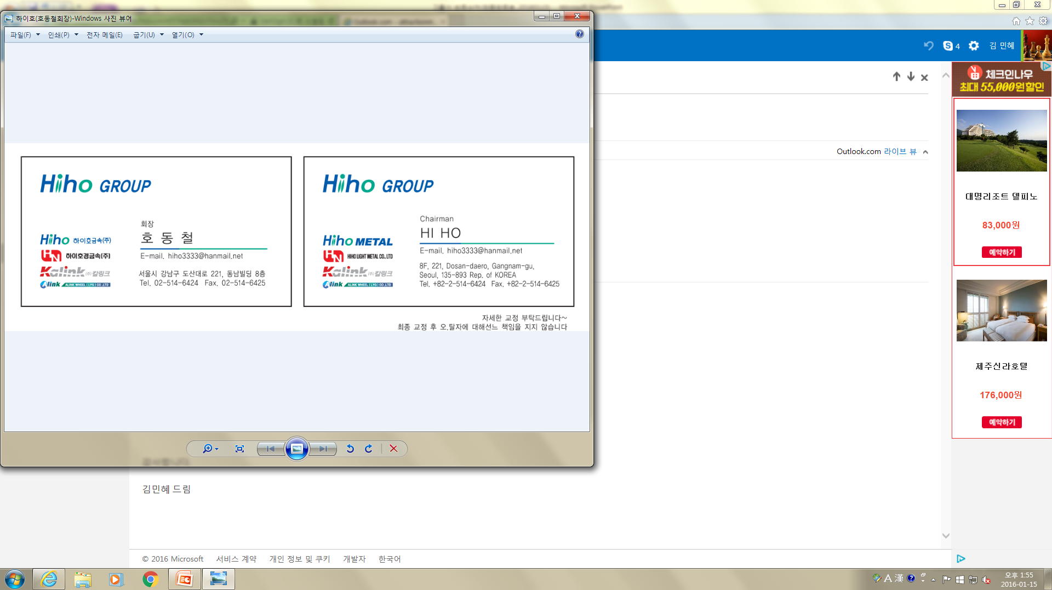



Group Overview
Trading
Casting
Recycling
Al Wheel
Plant

Slide 4
Group Overview
(Unit: USD Million)
Item | Establishment Date | CEO | Business Field | Capital | Executives & Employees | Location | Sales Amount <2020>
 | Oct. 2003 | Ho Dong Chull | Non-metal trading | 4 million | 30 | Gangnam-gu, Seoul City | 758
 | Oct. 2007 |  | Aluminum Alloy Manufacturing | 8.8 million | 120 | Gunsan City, Jeollabuk-do | 200
 | June 2000 | Ho Dong Chull | Al wheel Manufacturing Plant | 6.4 million | 275 | Gimjae City, Jeollabuk-do | 61.4
 | Nov. 2007 | Pyo Kyoung Cheon | Al wheel manufacturing | 78.3 million | 869 | Lianyungang, China | 157

Slide 5
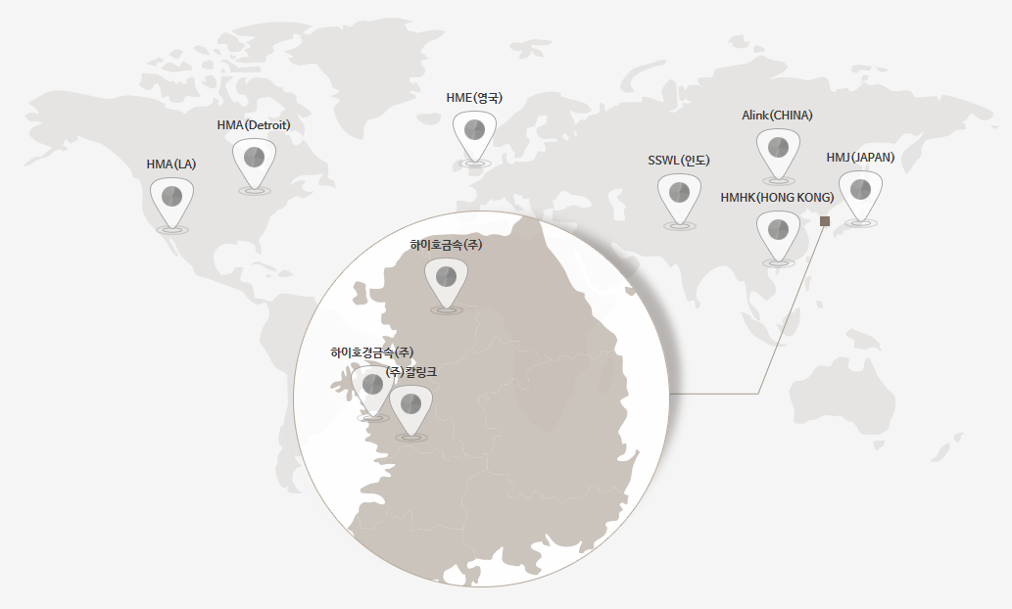
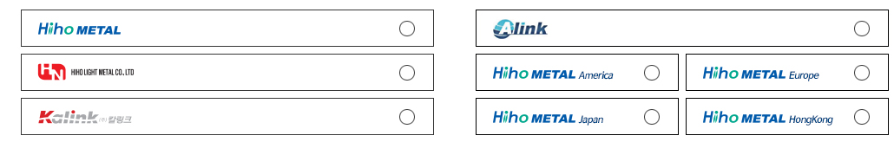





Group Overview
Hiho Metal
HMSGP(SINGAPORE)
Hiho Light Metal
Kalink
Domestic Corporation
Grobal corporation
Singapore
Notes:
국내법인 – Domestic companies
해외법인 – Overseas companies

Slide 6
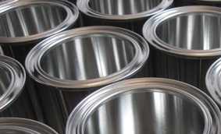
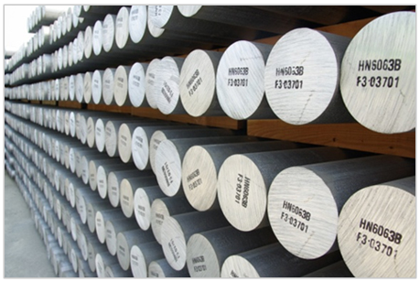
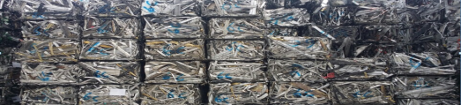
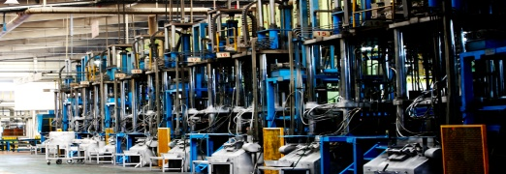
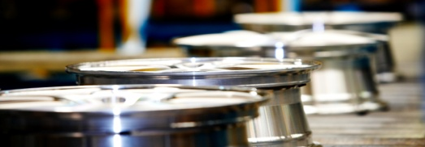
Business
TRADING
CASTING
RECYCLING
Import and export of
industrial aluminum
- Primary Ingot
- Primary Alloy
- Secondary Alloy
Alloy production
- Al Billet
- Al Ingot
Alloy production
- Al Scrap
PLANT
Al Wheel
Overseas export of alloy wheel production equipment and operation technology
(SSWL, India)
Automobile wheel manufacturing
- Alloy Wheel

Slide 7
Vision
Strives for the world’s best.
Aluminum businesses through mine development, smelting and production of final product
Global Business Leader
Enhanced competitiveness
In the global stage
Mine development
Raw material production
Import & Distribution (Hiho Metals)
Manufacturing (intermediate goods)
Manufacturing (end items)
Maximazation of
the value creation
Globalization & Localization
Notes:
광산개발- Mine development, 원자재생산- Raw material production, 원재료 수입유통(하이호금속㈜)-Import and distribution of raw materials (Hiho Metal Co. Ltd), 중간재 판매(하이오경금속㈜)- Sales of intermediate goods(Hiho Light Metal Co. Ltd)), 최종품 판매(㈜칼링크, Alink) – Sales of final product (Kalink Co. Ltd, Alink)

Slide 8

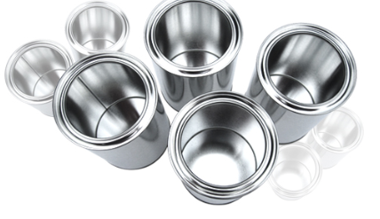

Hiho Metal
Company Name | Hiho Metal Co. Ltd
Establishment Date | Oct. 13th 2003
Name of CEO | Ho Dong Chull
Business Fields | Non-metal trading
Address | 8F, Nonhyeon Building, 556, Gangnam-daero, Gangnam-gu, Seoul
Telephone No. | 02) 514-6671
Facsimile No. | Sales: 02) 514-6425 Management: 02) 514-6489
Homepage | www.hihometal.com
History
Dec. 2018 | Sales amount of 1,184 million (Ordinary profit of 16.5 million)
Apr. 2018 | Established Hiho Metal Singapore Branch (HMSGP)
Apr. 2015 | Established Hiho Metal Hong Kong Branch (HMHK)
Dec. 2012 | Acquire Alink
Oct. 2012 | Established Hiho Metal Japanese branch (HMJ)
Dec. 2010 | Acquire Kalink
Dec. 2008 | Established Hiho Metal HME
Oct. 2007 | Established Hiho Light Metal
Sept. 2007 | Designed as Outstanding Corporate for Foreign Exchange Risk Management (SMBA)
Nov. 2006 | Designated as Management Innovative SME (SMBA)
Oct. 2003 | Established company

Slide 9
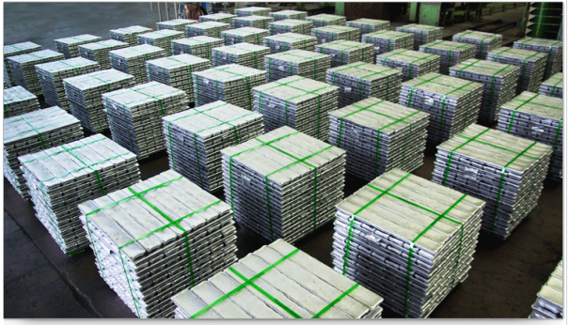
Business
We’ve grown into a representative company in the field of non-metal distribution based on distinct professionalism and know-how.
Business Sector
Primary Aluminum is imported from China then supplied to domestic rolling, pressing, wiring companies.
Products
Primary Aluminum
Aluminum Billet
Primary Al Alloy(A356.2, mastery alloy types)
Secondary Al Alloy(ALDC12, 10 etc.)
Wheel
Scrap
Purpose
Supplied to rolling/pressing/alloy/wheel manufacturing companies and others

Slide 10
IR Information
Sales Amount
Unit : USD million
2016 | 2017 | 2018 | 2019 | 2020
1,007 | 1,129 | 1,184 | 1,005 | 758
Ordinary Profit
Unit : USD million
2016 | 2017 | 2018 | 2019 | 2020
16.5 | 16.6 | 16.5 | 11.3 | 5.2

Slide 11

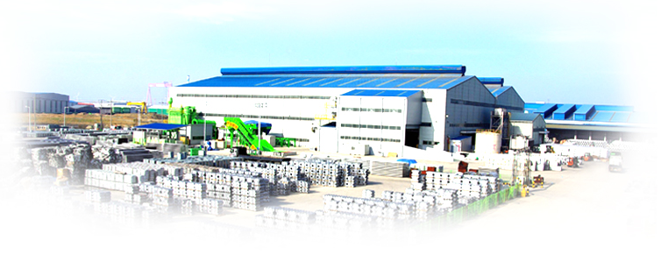
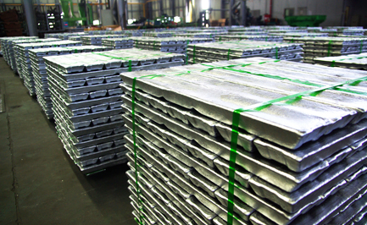
Hiho Light Metal
Company Name | Hiho Metal Coo. Ltd
Establishment Date | Oct. 24th 2007
Name of CEO | SEO IL SU
Business Fields | Aluminum alloy manufacturing
Address | 133, Saemangeumbuk-ro, Gunsan City, Jeonbuk
Telephone No. | 063) 472-1800
Facsimile No. | Sales: 063) 472-1940 Management: 063) 472-1999
Homepage | www.hiholme.com
History
Dec. 2018 | Sales amount of 451.9 million
Mar. 2014 | Good taxpayer commendation (Ministry of Strategy and Finance)
Dec. 2011 | Sales amount of 313.9million
Jan. 2011 | Patent application for the manufacturing method of alloy ingot
Dec. 2010 | Acquired INNO-BIZ
Oct. 2010 | Awarded with 100 million Venture Company Award
Dec. 2009 | Capital increased by 4.3 million (7.8 million after increase) Established company affiliated research center
Mar. 2009 | Certified as venture company
Nov. 2008 | Acquired ISO/TS 16949:2002 ISO 9001:2000 ISO 14001
Oct. 2007 | Established company

Slide 12
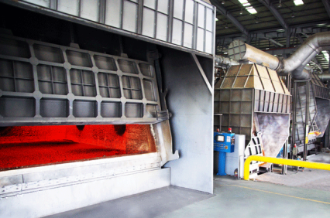
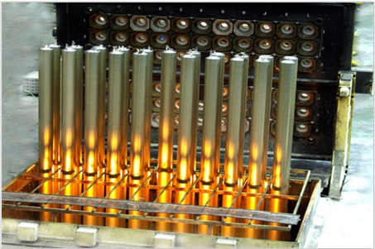
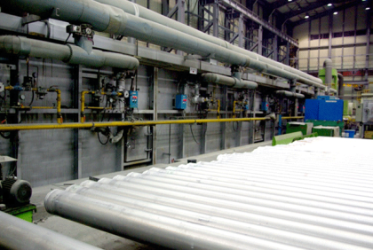
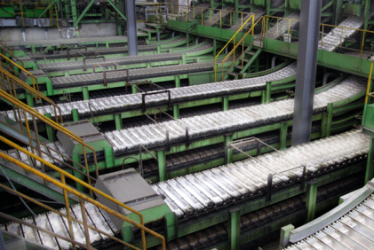
Business
Business Sector
Al Billet
1000 : Electrical/Air handling/chemical/food processing
3000 : Kitchen appliances/plate/Can Body
5000 : Vessel/welded structure/pressure container
6000 : For architecture/structure
RECYCLING
Al scrap production
Implementation of environment-friendly business
(Implementation of Al Scrap recycling)
생산공정
Smelting furnace
Wagstaff casting machine
Continuous homogeneous reactor
Continuous casting machine

Slide 13
IR Information
Sales Amount
Unit : USD million
2016 | 2017 | 2018 | 2019 | 2020
271.2 | 328.3 | 451.9 | 305.1 | 200
Ordinary Profit
Unit : USD million
2016 | 2017 | 2018 | 2019 | 2020
2.2 | 2.8 | 4.1 | 1.9 | 0.9

Slide 14
Capacity
Unit : MT
Area | Billet Line Capacity | Ingot Line Capacity
Land plot : 60,225 m² Building : 10,934 m² | All : 100,000 Melting : 200,000 Casting : 100,000 Homogeneity : 100,000 Cutting : 100,000 | All : 150,000 Melting : 150,000 Casting : 370,000
Production | 2016 | 2017 | 2018 | 2019 | 2020
Billet | 89,640 | 71,283 | 79,388 | 85,042 | 51,978
Ingot | 52,065 | 48,234 | 70,989 | 46,390 | 23,714
Total | 141,705 | 119,517 | 150,377 | 131,432 | 75,692

Slide 15
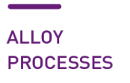
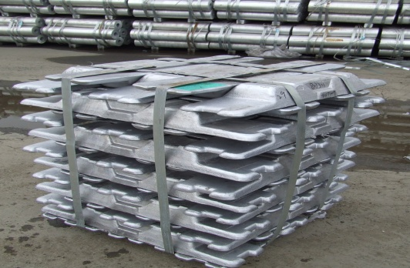

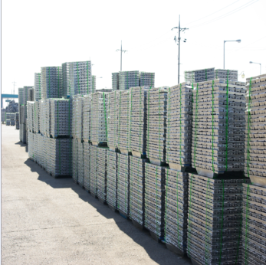
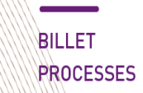

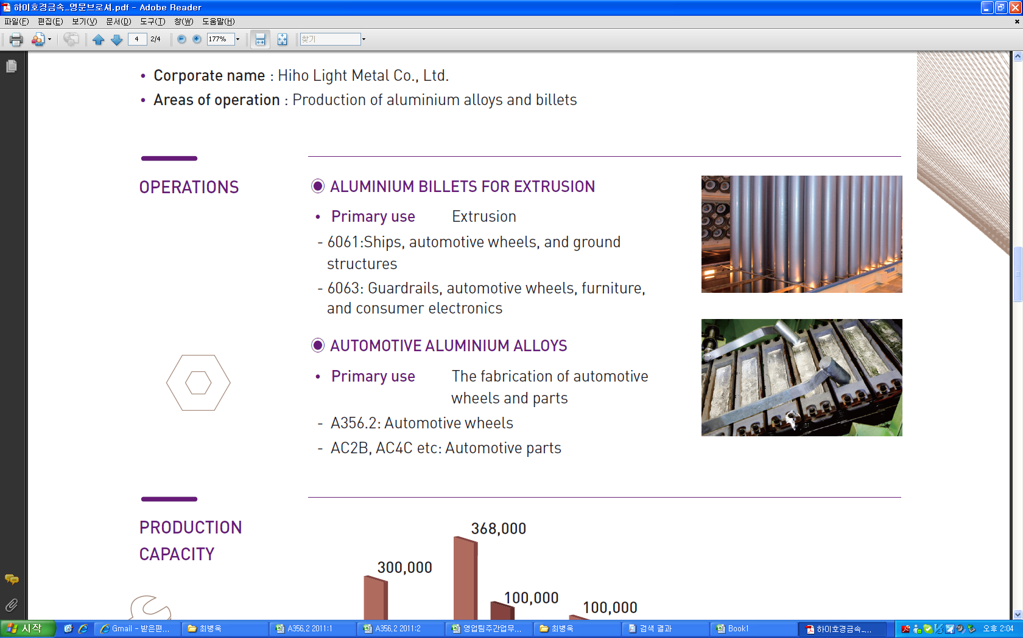
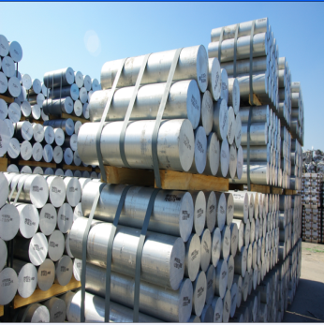
Facility Automation
Raw Material
Melting
Customers
Automatic Stacking
Casting
Release
Raw Material
Melting
Casting
Homogenizing
Release

Slide 16

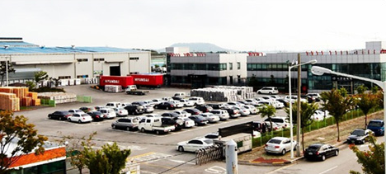
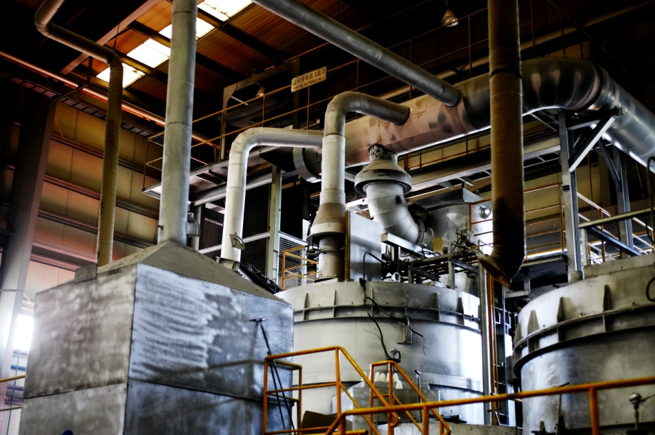
Kalink
Company Name | Kalink Co. Ltd
Establishment Date | Jun. 16th 2000
Name of CEO | Ho Dong Chull
Business Fields | Vehicle aluminum wheel manufacturing and sales of manufacturing equipment
Address | 37, Sundongsandan 17-gil, Gimjae City, Jeonbuk
Telephone No. | 063) 540-5300
Facsimile No. | 063) 540-5301
Homepage | www.kalink.co.kr
History
Sept. 2015 | Exported Al Wheel production equipment with SSWL in India
Oct. 2013 | Commenced mass production of VOLKSWAGEN products
Oct. 2012 | Commenced mass production of SUBARU products
May 2011 | Product supply agreement with VOLKSWAGEN & AUDI
Nov. 2008 | Change of company name (Jinwonmetech→Kalink) Construction completed for Chinese partner plant with production capacity of 1.5 million units
Dec. 2007 | Nissan (US,Jap,Eng) OEM VENDER registered
Nov. 2006 | $50 billion Export Tower Award (43rd Trade Day)
Dec. 2003 | Registered as CHRYSLER OEM VENDER in USA
Jun. 2000 | Established company (Jinwonmetech Co. Ltd)

Slide 17

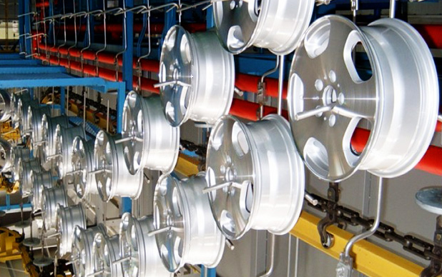
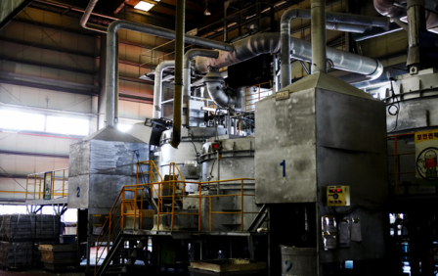
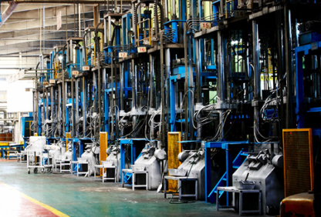
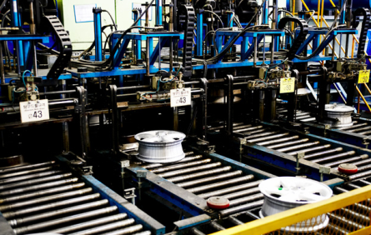
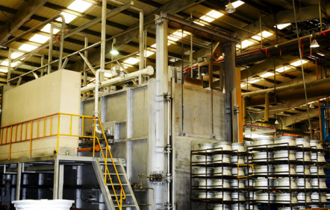
Business
Business Sector
Al Alloy Wheel
Manufacture of aluminum alloy (A356.2) Al Alloy Wheel
Export of production equipment and operation technology
We export production equipment and operation technology for plants based on global alloy wheel production technology.
<Agreement signed for Alloy Wheel production equipment and technical support with SSWL in India>
Production Process
Melting
Casting
탕구Drill
Heat treatment

Slide 18
IR Information
Sales Amount
Unit : USD million
2016 | 2017 | 2018 | 2019 | 2020
94.2 | 163.8 | 119.4 | 85.6 | 61.4
Ordinary Profit
Unit : USD million
2016 | 2017 | 2018 | 2019 | 2020
8.5 | 11.3 | 10.5 | 6.6 | 2.5

Slide 19
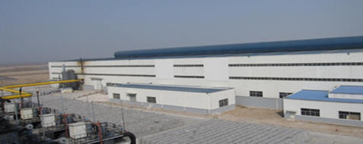
Alink
Company Name | ALINK WHEEL (LYG) CO., LTD
Establishment Date | Nov. 2007
Name of CEO | Pyo Kyoung Cheon
Business Fields | Manufacturing and sales of vehicle aluminum wheel
Address | No. 109, Dapu Road, Dapu Industrial Zone, Lianyungang City, Jiangsu, P.R. China
Telephone No. | +86-518-85792291
Facsimile No. | +86-518-85792290
Homepage | www.alinkwheel.com
History
Jan. 2013 | Introduced Flow-forming equipment for premium wheel production
Jan. 2012 | Passed Volkswagen’s plant audit
Oct. 2011 | Passed FIAT’s plant audit
Sept. 2011 | Increased production capacity to 2.5 million units
Oct. 2010 | Registered as CHRYSLER OEM VENDER in USA
Apr. 2009 | Registered as Nissan (China, USA, Japan, UK) OEM VENDER
Oct. 2008 | Commenced mass production of products
Nov. 2007 | Established company

Slide 20
IR Information
Sales Amount
Unit : USD million
2016 | 2017 | 2018 | 2019 | 2020
609.6 | 521.6 | 378.3 | 238.3 | 157
Ordinary Profit
Unit : USD million
2016 | 2017 | 2018 | 2019 | 2020
7.6 | 6.1 | 6.9 | 3.4 | 0.2

Slide 21
Capacity
Kalink(South Korea) |  | Alink(China)
Area | People | Area | People
Area : 25,192 m² Building: 14,022 m² | Total : 275 Office: 51 Plant: 224 R&D(Office): 7 Quality(Office): 5 Quality(Plant): 25 | Area : 99,000 m² Building: 55,000 m² | Total : 869 Office: 150 Plant: 719 R&D(Office): 18 Quality(Office): 8 Quality(Plant): 101
Unit : PCS
Plant | 2021 | 2022 | 2023 | 2024
Kalink | 1,800,000 | 1,800,000 | 1,800,000 | 1,800,000
Alink | 3,100,000 | 3,100,000 | 3,100,000 | 3,100,000
Mexico(under construction) |  | 1,500,000 | 1,500,000 | 2,500,000
India JV | 1,500,000 | 3,000,000 | 3,000,000 | 3,000,000
China JV(under construction) |  | 1,500,000 | 1,500,000 | 3,000,000
Total | 6,400,000 | 10,900,000 | 10,900,000 | 13,400,000

Slide 22
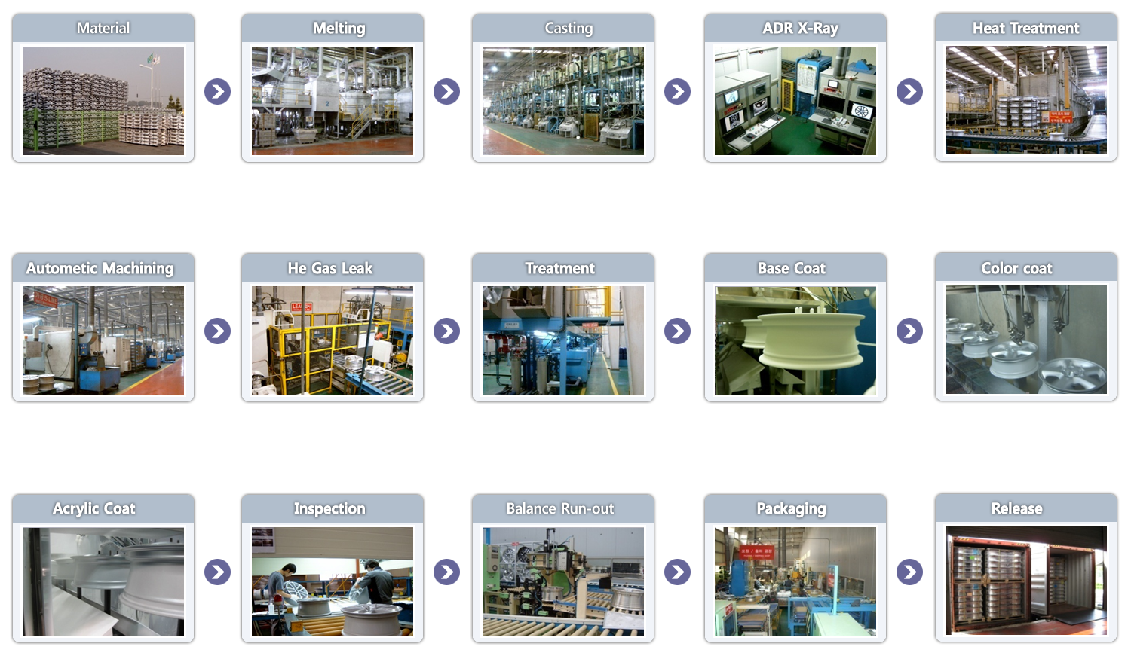
Process

Slide 23
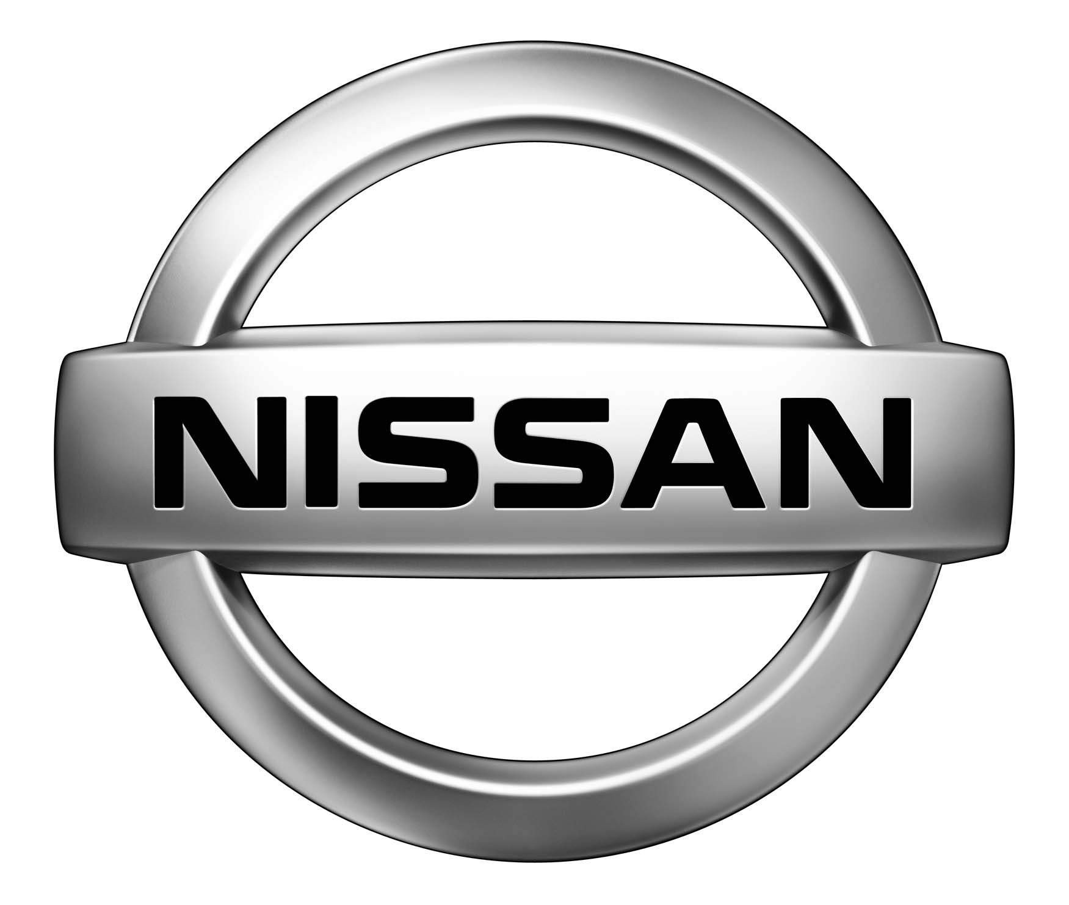




Customers
Car Maker |  | Programs | Remarks
 | JAPAN | MURANO, QASHQAI, JUKE, LEAF, ROGUE, PATROL, NOTE, SKYLINE COUPE, SERENA | From 2007
 | USA | ALTIMA, X-TEERA, LEAF, ROGUE, MURANO | From 2007
 | UK | QASHQAI, JUKE, LEAF, NOTE | From 2007
 | CHINA | QASHQAI, LEAF, ROGUE, MURANO | From 2010
 | SPAIN | PATHFINDER, NAVARA, NOTE, PULSAR | From 2011
 | GERMANY | GOLF, PASSAT, TIGUAN | From 2013
 | USA | B-SUV | From 2014
 | MEXICO | GOLF, GOLF GP, TIGUAN, JETTA | From 2014
 | BRAZIL & ARGENTINA | FOX, SURAN | From 2014
 | GERMANY | A3 | From 2014
 | USA | 200, PACIFICA | From 2004
 | CANADA | TOWN & COUNTRY, ROUTAN (VW) | From 2004
 | USA | DART, AVENGER, DURANGO, RAM 1500 | From 2010
 | CANADA | CARAVAN, JOURNEY | From 2007
 | USA | GRAND CHEROKEE | From 2011
 | JAPAN | FORESTER, EXIGA | From 2012
 | USA | LEGACY, IMPREZA | From 2014

Slide 24
End of Document
Hiho Group

